Slide 1
Chapter 6 Innovative Systems: From E-Government and E-Learning to C2C E-Commerce and Collaborative Commerce

Slide 2
LEARNING OBJECTIVES
Describe various e-government initiatives.
Understand e-government implementation issues including e-government 2.0 and m-government.
Describe e-learning, virtual universities, and e-training.
Describe e-books.
Describe knowledge management and dissemination as an e-business.
Describe C2C activities.
Describe collaborative commerce.

Slide 3
E-GOVERNMENT: AN OVERVIEW
What is e-government ?
E-commerce model in which a government entity buys or provides goods, services, or information to businesses or individual citizens electronically.
5 Major Categories
G2C (government to citizen)
G2B (government to business)
G2G (government to government)
G2E (government to employees)
IEE (internal efficiency and effectiveness)

Slide 4
E-GOVERNMENT: AN OVERVIEW
government-to-citizens (G2C)
E-government category that includes all the interactions between a government and its citizens. (e.g. www.gov.hk 香港政府一站通)
Electronic Voting (Brazil)
Electronic Benefits Transfer (what if no bank accounts?)
Electronic Tax Filing (eTax)
Electronic Driving License Renewal

Slide 5
E-GOVERNMENT: AN OVERVIEW
government-to-business (G2B)
E-government category that includes interactions between governments and businesses electronically (government selling to businesses and providing them with services, and businesses selling products and services to the government).
Government E-Procurement (e-RFQ or tendering)
Group Purchasing
Forward E-Auctions

Slide 6
E-GOVERNMENT: AN OVERVIEW
government-to-government (G2G)
E-government category that includes activities within government units and those between governments.
government-to-employees (G2E)
E-government category that includes activities and services between government units and their employees. (e.g. US Navy Lifelines – sailors keep in-touch with their families)

Slide 7
E-GOVERNMENT: AN OVERVIEW
Internal Efficiency and Effectiveness (IEE)
These internal initiatives provide tools for improving the effectiveness and efficiency of government operations:
E-payroll
E-records management
E-training
Enterprise case management
Integrated acquisition
Integrated human resources
One-stop recruitment

Slide 8
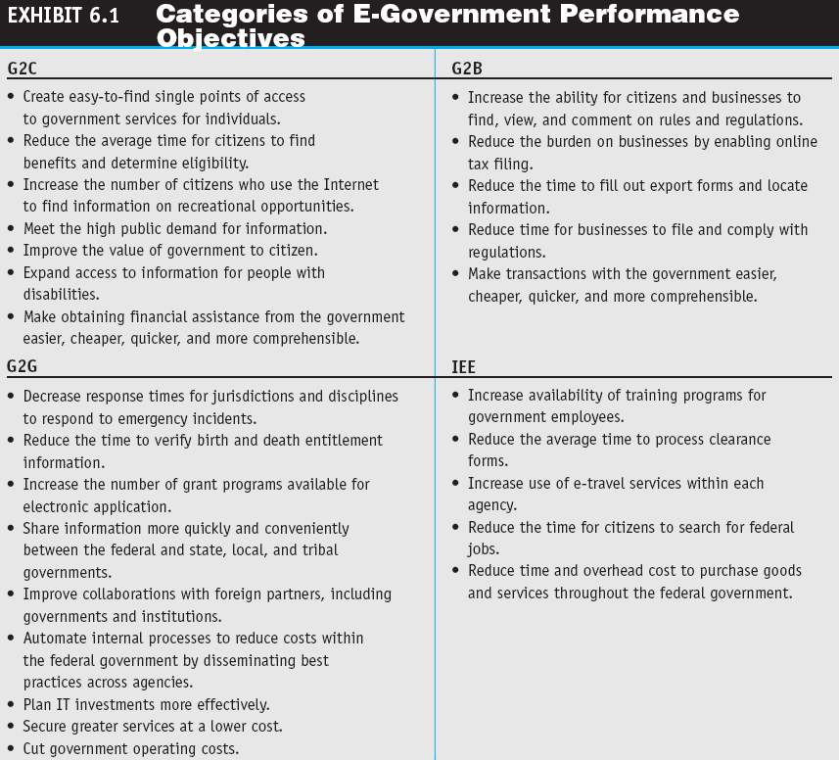

Slide 9
E-GOVERNMENT: AN OVERVIEW
IMPLEMENTING E-GOVERNMENT
THE TRANSFORMATION TO E-GOVERNMENT
(currently still very portal-based and top-down, one-stop shop approach)
E-GOVERNMENT 2.0 AND SOCIAL NETWORKING
mobile government (m-government)
The wireless implementation of
e-government mostly to citizens but also to businesses. (eg. send sms during emergency)

Slide 10
E-LEARNING
e-learning
The online delivery of information for purposes of education, training, or knowledge management.

Slide 11
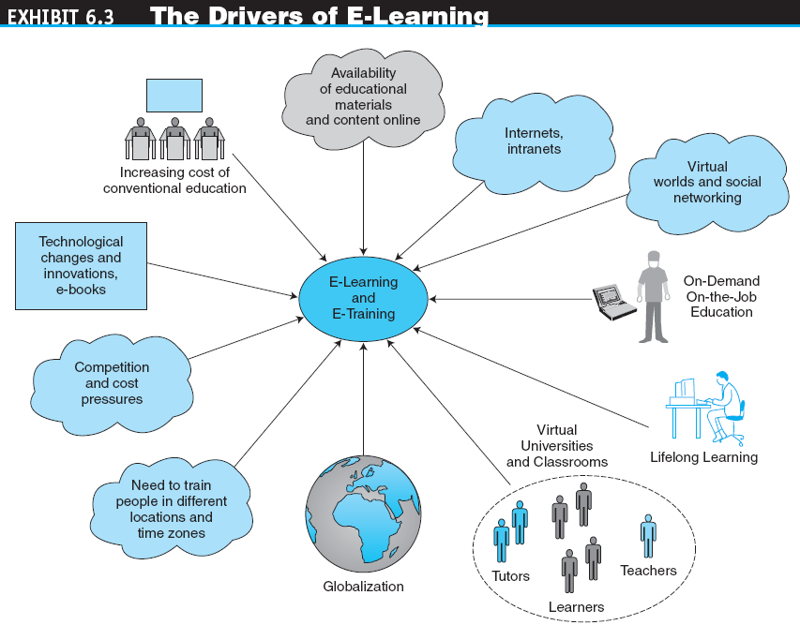

Slide 12
E-LEARNING
BENEFITS OF E-LEARNING
Time reduction
Large volume (people) and diversity
Cost reduction
Higher content retention
Flexibility
Updated and consistent material
Fear-free environment (especially for people who do not lke face-to-face open discussion)

Slide 13
E-LEARNING
DRAWBACKS OF E-LEARNING
Need for instructor retraining (not used to give training electronically (facing camera, webcam etc)
Extra money to buy equipment and support services
Lack of face-to-face interaction and campus life
Assessment (no guarantees who finishes the papers)
Maintenance and updating
Protection of intellectual property (difficult to protect electronically)
Computer literacy (what if no computers?)
Student retention

Slide 14
E-LEARNING
distance learning
Formal education that takes place off campus, usually, but not always, through online resources.
virtual university
An online university from which students take classes from home or other offsite locations, usually via the Internet.

Slide 15
E-LEARNING
ONLINE CORPORATE TRAINING
IMPLEMENTING E-LEARNING AND E-TRAINING
SOCIAL NETWORKS AND E-LEARNING
LEARNING IN VIRTUAL WORLDS AND SECOND LIFE
VISUAL INTERACTIVE SIMULATION
E-LEARNING TOOLS AND MANAGEMENT
Examples : www.e-learning.co.uk, www.learnhub.com)

Slide 16
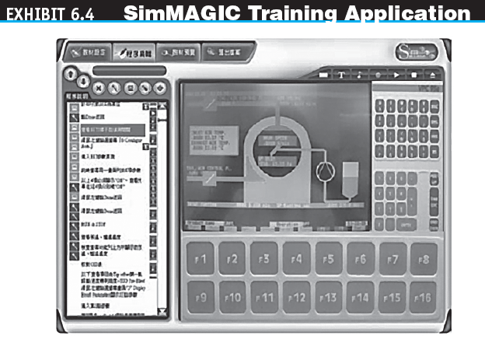

Slide 17
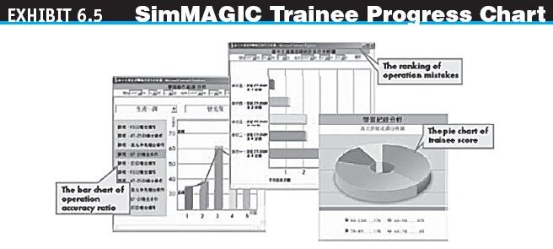

Slide 18
E-LEARNING
e-book
A book in digital form that can be read on a computer screen or on a special device.
E-books can be delivered and read via
Web access
Web download
A dedicated reader
A general-purpose reader
A Web server

Slide 19

E-LEARNING
Devices for Reading
E-Books
Amazon.com’s Kindle 2
The Sony PRS-200
Barnes and Noble’s Nook
iPad

Slide 20
E-LEARNING
Advantages of E-Books
Lower cost
Portability
Easy search capabilities and links
Easy downloading
Ability to quickly and inexpensively copy material
Easy integration of content with other text
Easy updating
No wear and tear on a physical book
Ability to find out-of-print books
Books can be published and updated quickly so they can be kept current

Slide 21
E-LEARNING
Limitations of E-Books
They require hardware and software that may be too expensive for some readers
Some people have difficulty reading large amounts of material on a screen
Batteries may run down
There are multiple competing standards

Slide 22
KNOWLEDGE MANAGEMENT, LEARNING, AND E-COMMERCE
knowledge management (KM)
The process of capturing or creating knowledge, storing it, updating it constantly, disseminating it, and using it whenever necessary.

Slide 23
KNOWLEDGE MANAGEMENT, LEARNING, AND E-COMMERCE
KM TYPES AND ACTIVITIES
Create knowledge
Capture knowledge
Refine knowledge
Store knowledge
Manage knowledge
Disseminate knowledge
Knowledge Sharing

Slide 24
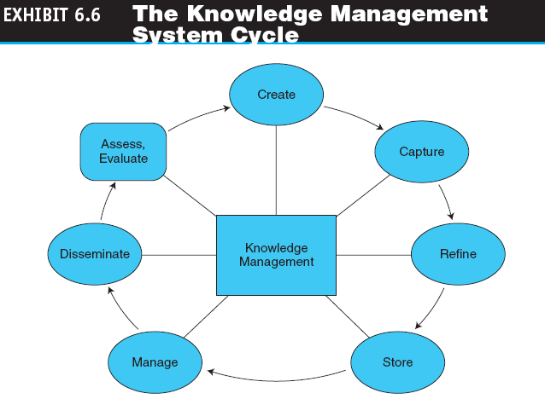

Slide 25
KNOWLEDGE MANAGEMENT, LEARNING, AND E-COMMERCE
HOW IS KNOWLEDGE MANAGEMENT RELATED TO E-COMMERCE?
KM and Social Networks
Knowledge creation
Knowledge sharing

Slide 26
KNOWLEDGE MANAGEMENT, LEARNING, AND E-COMMERCE
ONLINE ADVICE AND CONSULTING
Medical advice
Management consulting
Legal advice
Gurus
Financial advice
Social networks
Other advisory services

Slide 27
KNOWLEDGE MANAGEMENT, LEARNING, AND E-COMMERCE
EMPLOYEE KNOWLEDGE NETWORKS AND EXPERT LOCATION SYSTEMS
Finding Experts Electronically
expert location systems (ELS)
Interactive computerized systems that help employees find and connect with colleagues who have expertise required for specific problems—whether they are across the country or across the room—in order to solve specific, critical business problems in seconds.
Seeking Expertise in Social Networks

Slide 28
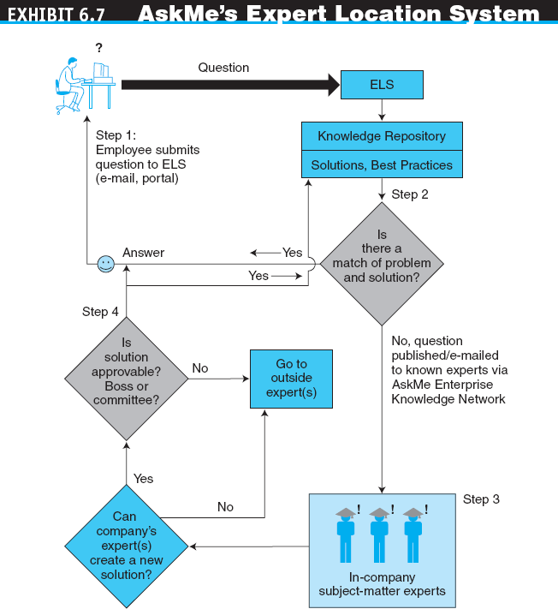

Slide 29
CONSUMER-TO-CONSUMER ELECTRONIC COMMERCE
consumer-to-consumer (C2C)
E-commerce model in which consumers sell directly to other consumers. (e.g. ebay.com)

Slide 30
CONSUMER-TO-CONSUMER ELECTRONIC COMMERCE
E-COMMERCE: C2C APPLICATIONS
C2C Auctions
Classified Ads
Personal Services (e.g. domestic helpers)
Napster and Others—File-Sharing Utilities
C2C Activities in Social Networks and Trading Virtual Properties

Slide 31
COLLABORATIVE COMMERCE
collaborative commerce
(c-commerce)
The use of digital technologies that enable companies to collaboratively plan, design, develop, manage, and research products, services, and innovative EC applications.

Slide 32
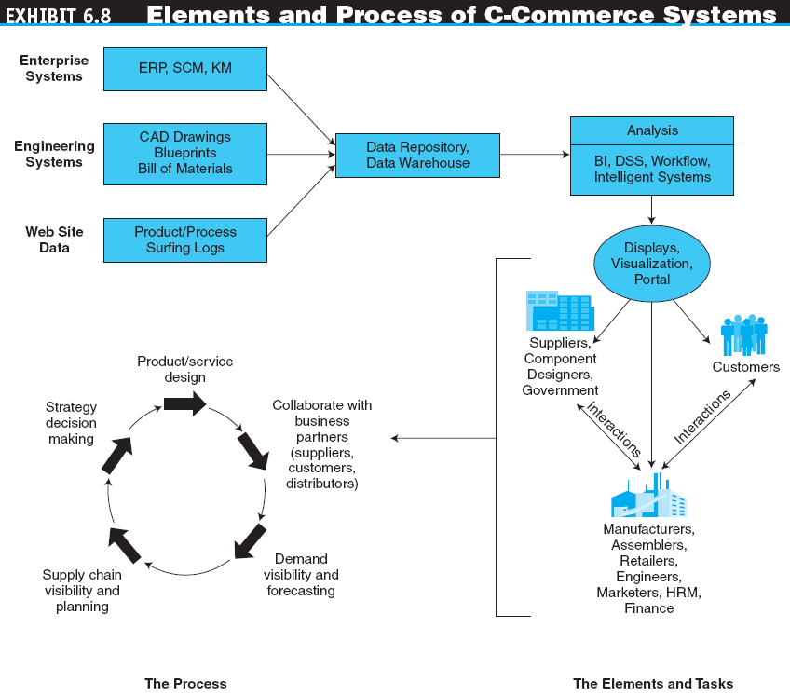

Slide 33
COLLABORATIVE COMMERCE
collaboration hub
The central point of control for an e-market. A single c-hub, representing one e-market owner, can host multiple collaboration spaces (c-spaces) in which trading partners use c-enablers to exchange data with the c-hub.

Slide 34
COLLABORATIVE COMMERCE
IMPLEMENTING C-COMMERCE
Example: Design with C-Commerce (Dell, Cisco, Boeing)
BARRIERS TO C-COMMERCE
Technical factors involving a lack of internal integration, standards, and networks
Security and privacy concerns, and some distrust over who has access to and control of information stored in a partner’s database
Internal resistance to information sharing and to new approaches
Lack of internal skills to conduct c-commerce

Slide 35
MANAGERIAL ISSUES
What are the e-government opportunities?
How do we design the most cost-efficient government e-procurement system?
How do we design the portfolio of e-learning knowledge sources?
How do we incorporate social networking–based learning and services in our organization?

Slide 36
MANAGERIAL ISSUES
Can we capitalize on C2C EC?
How do we connect our expert location system and social networking initiatives?
What will be the impact of the e-book platform?
How difficult is it to introduce e-collaboration?

